Slide 1

Daria Solodey
Methodologist, course creator, English teacher

Slide 2
🔥
Our goal
Pass a job interview
Our rules:
Turn on your camera
Set up your microphone
Be active
Notes:
Если вам не хватило места, вы можете здесь написать развернутый комментарий.

Slide 3




Classroom language
Read the quote
Read the sentence
Read the text/story
Excuse me
Can I ask a question?
Could you repeat that please?
I agree (with the quote/with you)
I disagree = I don’t agree (with…)
Write your answer (in the chat)✍🏻
Listen and repeat (after me) 👂🗣
Watch the video 👀
Match the words with the pictures.
Choose the correct option
Do you have any questions?
❔
Answer the question…
Do you agree?
Is it true or false?
❔❔❔❔❔❔
Notes:
Я б хотіла запровадити собі такий вормап зі студентами, особливо для elementary

Slide 4
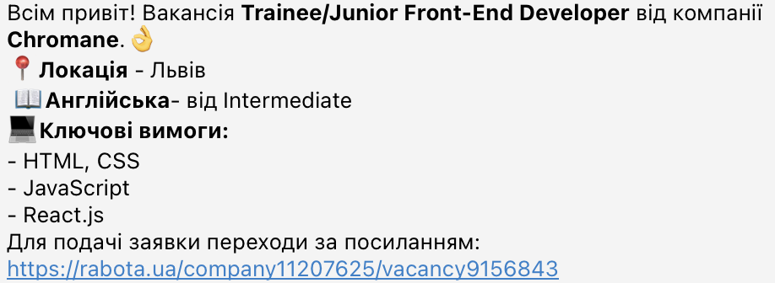
It’s time to learn English!

Slide 5

Lesson Plan:
Study word order in questions
Practice answering the interview question “Tell me about yourself”
Notes:
Развернутый комментарий.

Slide 6
Choose any number from 1 to 3.
1 2 3

Slide 7
This number is a number of facts that you have to say about yourself.
1 2 3

Slide 8


Look at Jack. Why is he so excited?
Is it challenging to pass a job interview? Why (not)?

Slide 9
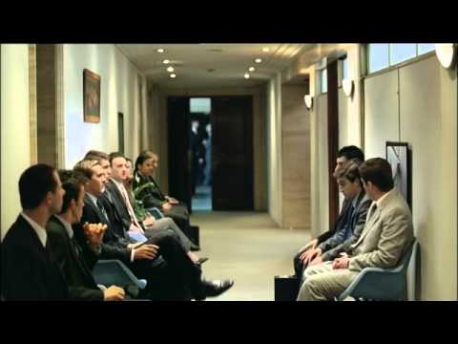
Why do you think some people fail their job interviews?
Have you ever failed your job interviews? Why?
Watch the video.
Is it a good way to get
a job?
Would it actually work in real life?

Slide 10


Slide 11
Before we watch the video, let’s practise the new words
Bachelor’s degree
Master’s Degree
To take the path of
Bold career shift
To be endorsed by
To be cut out for
Brave changing the type of job or profession you’ve been doing
Given one's public approval or support
A degree that is given to a student by a college or university usually after one or two years of additional study
To be naturally able or suited to do or be (something)
To start your career in a new sphere
A degree that is given to a student by a college or university usually after four years of study

Slide 12
Before we watch the video, let’s practise the new words
Bachelor’s degree
Master’s Degree
To take the path of
Bold career shift
Endorsed by
To be cut out for
Brave changing the type of job or profession you’ve been doing
Given one's public approval or support
A degree that is given to a student by a college or university usually after one or two years of additional study
To be naturally able or suited to do or be (something)
To start your career in a new sphere
A degree that is given to a student by a college or university usually after four years of study

Slide 13
Answer the questions. Use the phrases below.
Have you got a bachelor’s degree? If yes, which subject do you have a degree in? If no, would you like to have it?
Have you got a master’s degree? If yes, which subject do you have a degree in? If no, would you like to have it?
Have you ever made a bold career shift? Would you like to make it now?
Have you taken any courses endorsed by high-profile institutions?
Why have you decided that you are cut out for
working in IT?
Use the phrases:
I really feel that…
To my mind…
I guess/believe that…
Let me think…
To be honest...

Slide 14

Watch the video till (1:36-3:31) and answer the questions
What degrees did Mr Torres complete?
Is his education relevant to the position he is applying for?
What was his first job? Is it relevant experience? Did he like it?
Was the answer to the first question short or long?
What additional question did the employer ask? What did
Mr Torres answer? What details did he provide?

Slide 15
Mark the sentences as TRUE or FALSE. Explain yourself.
F
Mr Torres tells the employer about his age and marital status.
He speaks about relevant education.
His answer to the question “Tell me about yourself” is long and detailed.
Mr Torres provides additional information about his background only when the employer asks him about it.
T
F
T

Slide 16
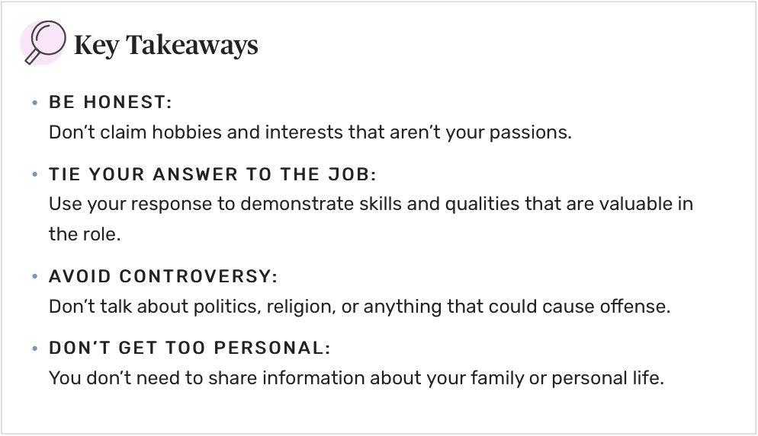
Read the tips one by one. Explain why each point important.

Slide 17
“Tell me about yourself” for software developers
I am… (Daniel Smith).
I am… (a full-stack developer).
I know… (CSS, JavaScript)
I did __ team and __ individual projects.
(One of my projects was a website for a flower shop)
I want to work for your company, because…
Have a great enthusiasm for
Use experience fully
* don’t use “junior”, as it may negatively influence your salary
* use only relevant info

Slide 18
Homework
Answer the interview question Tell me about yourself (see pr. slides) and send to your teacher for proofreading
Learn the glossary for the next lesson
Revise the glossary and presentation for this lesson
Additional grammar tasks:
English Grammar: Should you use DO or BE? · engVid

Slide 19

What have you learnt this lesson?
I can:
make up questions correctly
answer the interview question “Tell me about yourself”
Notes:
Развернутый комментарий

Slide 20
Useful links:
Video:
Tell Me About Yourself - Job Interview

Slide 21
Thank you!

